Slide 1
Human Computer Interaction
Fundamentals and Practice [ SWE - 431 ]
Gerard Jounghyun Kim
Chapter: 1
Introduction
Mahfuzur Rahman Emon Lecturer, IICT, SUST

Slide 2


Human Computer Interaction
Chapter 1: Introduction
Human–Computer Interaction (HCI): is a cross-disciplinary area (e.g., engineering, psychology, ergonomics, design) that deals with the theory, design, implementation and evaluation of the ways that humans use and interact with computing devices.
Interaction refers to an abstract model that describes how humans engage or communicate with a computing device to accomplish a particular task. An interface, on the other hand, is the concrete realization or implementation of the interaction model. Can be either hardware or software. The letter 'I' in HCI refers to both interaction and interface, emphasizing the importance of understanding both the abstract model of interaction and the tangible tools or methods used for that interaction.
The early focus of HCI has been in how to design interaction and implement interfaces for high usability. High usability means easy to use, efficient for the task, ensure safety, and lead to a correct completion of the task.
The simple aesthetic appeal of interfaces is now a critical added requirement for commercial success as well. Ex. distinctly designed Apple, Google, Samsung products.

Slide 3
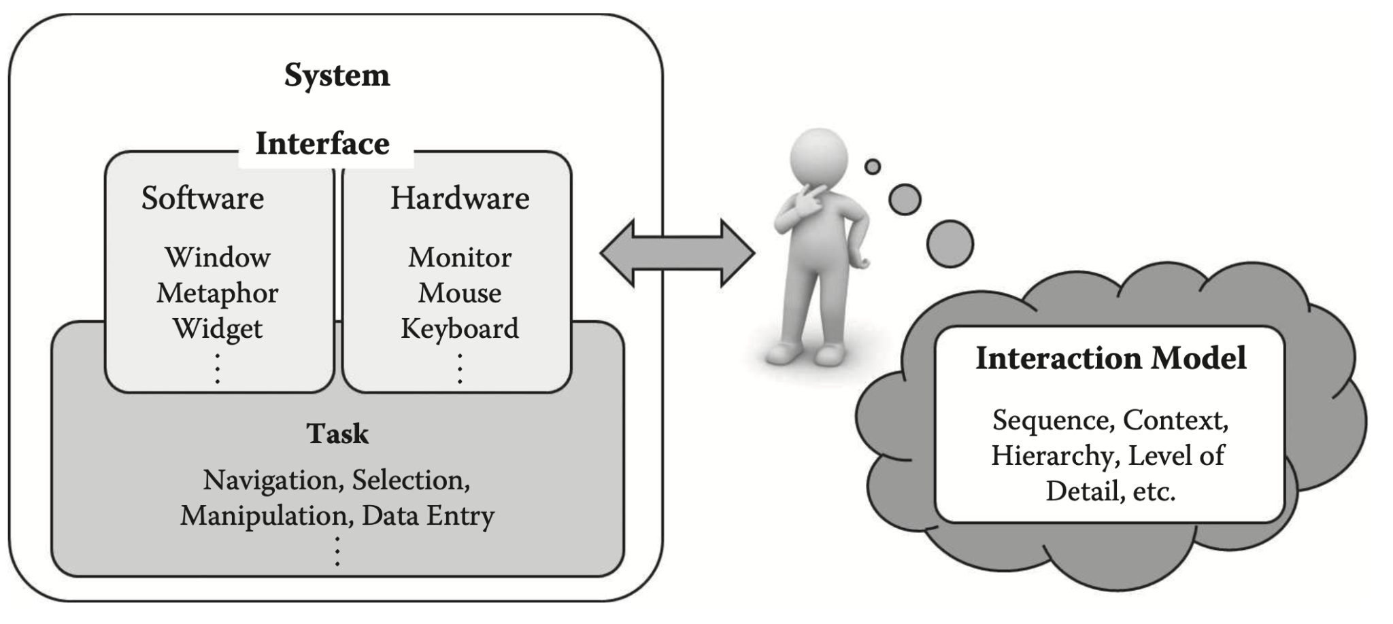
Human Computer Interaction
Chapter 1: Introduction
Human Computer Interaction
Chapter 1: Introduction
Human Computer Interaction
Chapter 1: Introduction
The distinguishing concepts of interaction (model) and interface.

Slide 4
Human Computer Interaction
Chapter 1: Introduction
The concept of user experience (UX) has lately become a buzzword, a notion that not only encompasses the functional completeness, high usability, and aesthetic appeal of the interactive artifact, but also its seamless integration into one’s lifestyle or even creating a new one around it.
Goals of HCI:
Functional completeness
High usability
Aesthetic appeal
Compelling user experience
Some historical and impacting changes with the interaction of human and computer:
The invention of the mouse that was the linchpin in the personal computer revolution.
The spreadsheet interface made business computing a huge success.
The Internet phenomenon could not have happened without the web-browser interface.
Smartphones, with their touch-oriented interfaces.
Body-based and action oriented interfaces are now introducing new ways to play and enjoy computer
games.

Slide 5
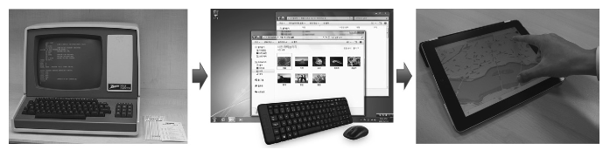
Human Computer Interaction
Chapter 1: Introduction
The evolution of interfaces in course of the history of computing. Terminal and keyboard -> Graphic UI and mouse -> Handheld and touch based interface

Slide 6
Human Computer Interaction
Chapter 1: Introduction
Challenges of good HCI design
Simultaneous consideration of many things such as
Types of users
Characteristics of the tasks
Capabilities and cost of the devices
Lack of objective
Changing technologies
A considerable knowledge in many different fields is required
Balancing Simplicity and Complexity.
User Expectations vs. Innovation

Slide 7
Human Computer Interaction
Chapter 1: Introduction
Principles of HCI
Over the relatively young history of HCI, researchers and developers in the field have accumulated and established basic principles for good HCI design in hopes of achieving some of the main objectives. These HCI principles are general, fundamental, and commonsensical, applicable to almost any HCI design situation.
Know Thy User
Understand the Task
Reduce Memory Load
Strive for Consistency
Remind Users and Refresh Their Memory
Prevent Errors/Reversal of Action
Naturalness

Slide 8
Human Computer Interaction
Chapter 1: Introduction
Know Thy Users
Interaction and interface should cater to the needs and capabilities of the target user. The foremost creed in HCI is to create interaction and interfaces around the target users.
Challenge in User Understanding:
HCI designers often proceed without a full understanding of the user. They proceed by guessing.
Comprehensive information about the target user (e.g., age, gender, education, computing experience, cultural background) is crucial to determine their probable preferences, tendencies, skill levels and capabilities.
Age-related differences in adopting new interfaces (e.g., young adults vs. older generations).
Gender-related differences in spatial ability may impact interface design.
Leveraging Knowledge from Psychology and Ergonomics:
Use cognitive psychology, ergonomics, and anthropomorphic data to assess user capabilities.
Field study feasibility may be limited, so leverage existing knowledge.
Notes:
Cognitive psychology: is a branch of psychology that focuses on mental processes such as "thinking, problem-solving, memory, and perception.
Ergonomics is the study of designing equipment and devices that fit the human body and its cognitive abilities In the context of HCI, ergonomics involves designing interfaces and devices that are physically comfortable and efficient for users. This includes considerations such as the placement of controls, the size of buttons, and the overall layout to reduce physical strain and enhance usability.
Anthropomorphic data relates to the measurement and analysis of human body characteristics and movements.
Application in HCI: Understanding anthropomorphic data helps designers create interfaces that are well-suited to the physical dimensions and movements of users.

Slide 9
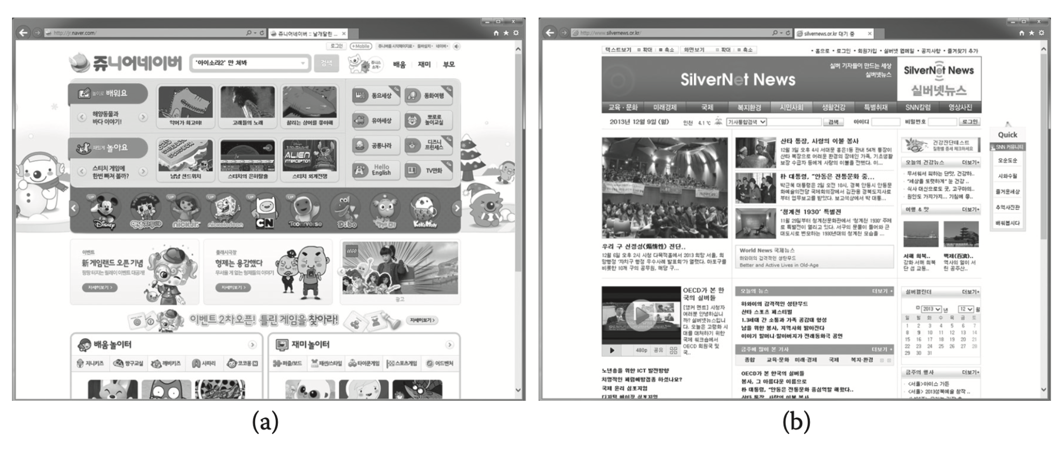
Human Computer Interaction
Chapter 1: Introduction
Examples of user-centered designs of web pages for (a) kids and (b) the elderly.

Slide 10
Human Computer Interaction
Chapter 1: Introduction
Universal Usability Concept:
"Universal usability" promotes interfaces catering to a wide range of users.
Challenges in achieving this with a single interface due to diverse user groups.
Investment for Universal Usability:
Government web pages in advanced countries legally required to provide interfaces in different languages and for color-blind and visually challenged users.
Many interactive systems provide both menu-driven commands for novices and keyboard-based hot keys for experts.
And ?

Slide 11
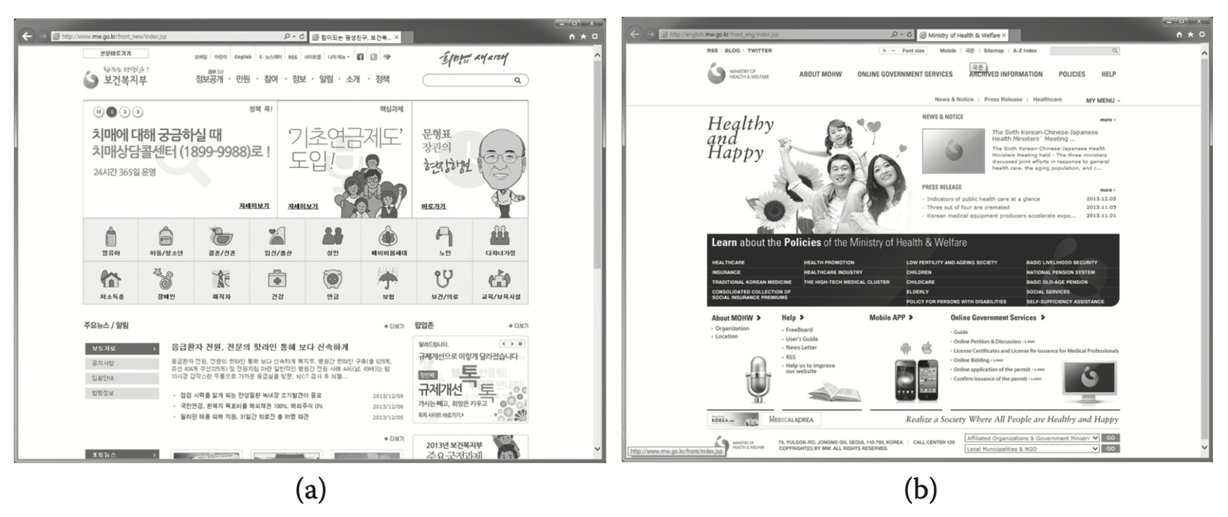
Human Computer Interaction
Chapter 1: Introduction
Two different interfaces to achieve universal usability (one in Korean and the other in English)

Slide 12
Human Computer Interaction
Chapter 1: Introduction
Understand the Task
HCI design should be based on a thorough understanding of the task the user aims to accomplish with the interactive system.
The term "task" refers to the specific job that the user intends to complete through the use of the interactive system.
Design involves identifying the sequence and structure of the tasks and associate subtasks within the larger application context. This requires abstraction at a level suitable for the typical user.
The task or interaction model should ideally come from the user. Different users have different mental models, and the interface should reflect these to simplify implementation for all users. But as humans are very adaptive in some cases tasks can be modeled solely based on general human capabilities.

Slide 13
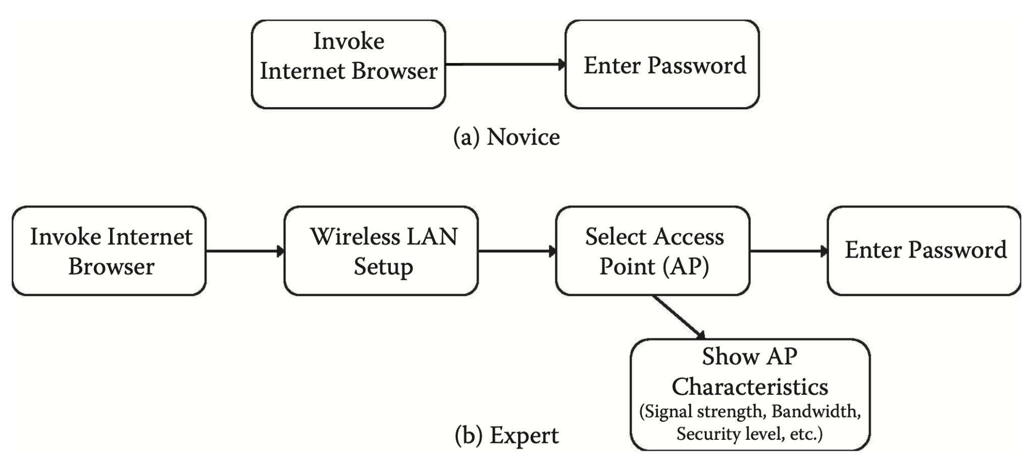
Human Computer Interaction
Chapter 1: Introduction
Take the subtask (for a larger application) for “changing the Wi-Fi connection access point” for a smartphone.
For an expert user experienced in computer networks, the task might be modeled with detailed steps, asking the user to select from a pool of available nearby access points based on their characteristics such as the signal strength, bandwidth, security level, and so forth
For a casual user, the subtask might only involve entering a password for the automatically selected access point

Slide 14
Human Computer Interaction
Chapter 1: Introduction
Reduce Memory Load
Designing interaction with as little memory load as possible.
Humans are certainly more efficient in carrying out tasks that require less memory burden, long or short term.
Human short-term memory (STM) has a limited capacity of about 5–9 chunks of information, commonly known as the "magic number." Designers should aim to keep the short-term memory load within this capacity to optimize user performance.
The interface plays a crucial role as a quick and easy guide to help users complete tasks. Reducing short-term memory load is essential for maintaining a smooth and effective interaction.
Light memory burden contributes to less erroneous behavior during task execution.
Interface design should consider the limitations of short-term memory in users. Examples include keeping the number of menu items or the depth of interactions below the 5–9 chunk threshold.

Slide 15
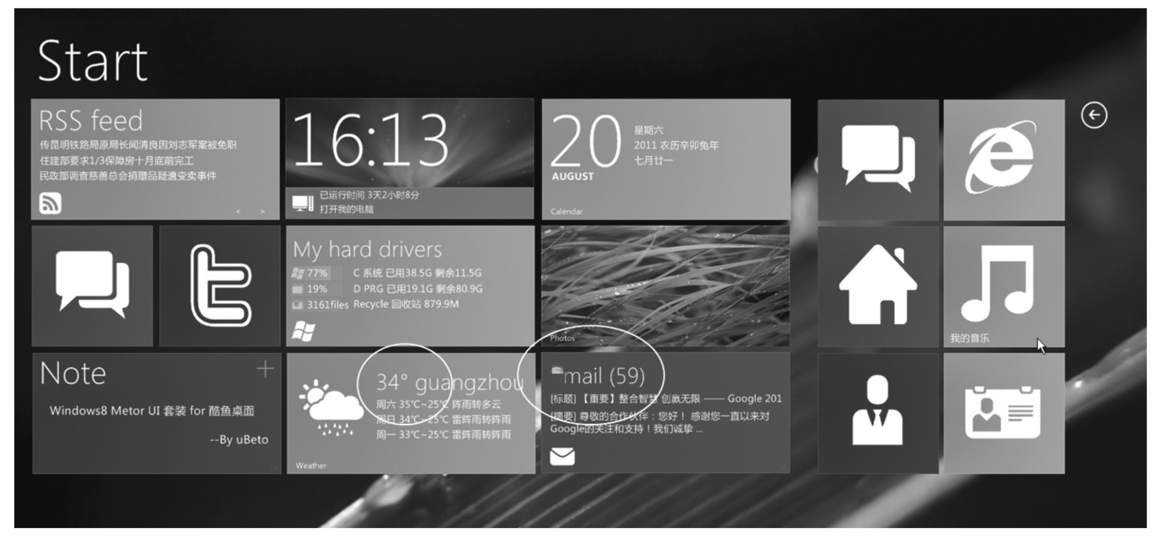
Human Computer Interaction
Chapter 1: Introduction
Interfaces designed for minimal short-term memory: (a) a menu system with fewer than 10 items (left) and (b) categorization by colors, areas, icons, and labels. Badges are used to display status information such as the current weather (see circled portions) and number of unread mails as a constant reminder.

Slide 16
Human Computer Interaction
Chapter 1: Introduction
Strive for Consistency
One way to unburden the memory load is to keep consistency. Applies both to
Both within an application and across different applications.
Both the interaction model and interface implementation.
The user is likely to get confused and exhibit erroneous responses if the same subtask is involved, at different times, for different interaction steps or interface methods. [Eg. font color on google office suite.]
Consistency and familiarity also lead to higher acceptability and preference

Slide 17
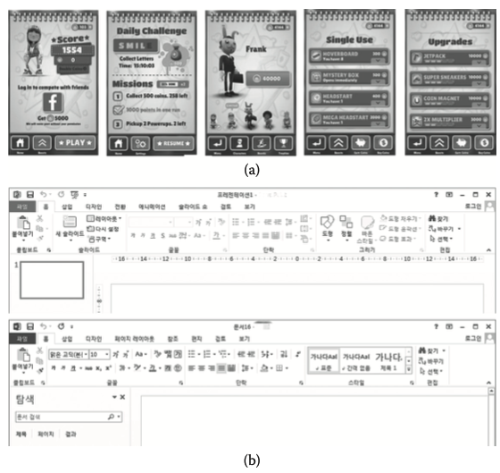
Human Computer Interaction
Chapter 1: Introduction
(a) A consistent look of the interface within an application.
(b) A consistent interface between Microsoft PowerPoint and Word.

Slide 18
Human Computer Interaction
Chapter 1: Introduction
Remind Users and Refresh Their Memory
The human memory dissipates information quite quickly, and this is especially true when switching tasks in multitasking situations
Another good strategy is to employ interfaces that give continuous reminders of important information and thereby refresh the user’s memory
A single task may proceed in different contextual spans. For instance, in an online shopping application, one might cycle through the entry of different types of information: item selection, delivery options, address, credit card number, number of items, etc.
To maintain the user’s awareness of the situation and further elicit correct responses, informative, momentary will refresh the user’s memory and help the user complete the task easily.
One particular type of informative feedback (aside from the current status) is the reaffirmation of the user action to signal the closure of a larger process [6]. An example might be not only explicitly confirming the safe receipt of a credit card number, but also signaling that the book order is complete (and “closed”).

Slide 19

Human Computer Interaction
Chapter 1: Introduction
Reaffirming the user’s action (i.e., credit card number correctly and securely entered) and a larger interactive process (i.e., the book purchase is complete).

Slide 20
Human Computer Interaction
Chapter 1: Introduction
Prevent Errors/Reversal of Action
One effective technique is to present only the relevant information as required at a given time. Inactive menu items are good examples of such a technique.
having the system require the user to choose from possibilities (e.g., menu system) is generally a safer approach than to rely on recall (direct text input).
Despite employing some of the principles and techniques described here, there is always a chance that the user will make mistakes.
A very obvious but easy-to-forget feature is to allow an easy reversal of action

Slide 21
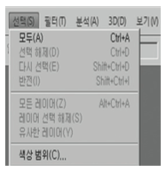
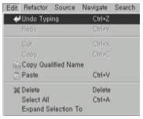
Human Computer Interaction
Chapter 1: Introduction
Preventing errors by presenting only the relevant information at a given time (inactive menu items) and making selections rather than enforcing recall or full manual input specifications
Making the user comfortable by always allowing an easy reversal of action

Slide 22
Human Computer Interaction
Chapter 1: Introduction
Naturalness
The final major HCI principle is to favor “natural” interaction and interfaces. Naturalness refers to a trait that is reflective of various operations in our everyday life.
For instance, a perfect HCI may when a natural language based conversational interface, because this is the prevalent way that humans communicate.
As it can be tricky, a better approach is to model interaction “metaphorically” to the real life counterpart
A natural or metaphoric interface will also have affordance, a property that appeals to our innate perception and cognition, thus making it so intuitive that the interface would require almost no learning

Slide 23
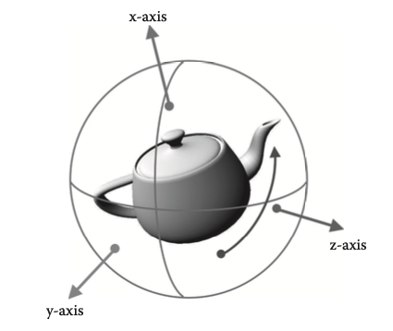
Human Computer Interaction
Chapter 1: Introduction
ARCBall: 3-D object rotation by using the sphere metaphor. It is also very intuitive with a high level of affordance

Slide 24
Human Computer Interaction
Chapter 1: Introduction
Thank you!

